Slide 1
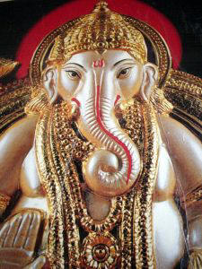
Learning About World Religions: Hinduism

Slide 2
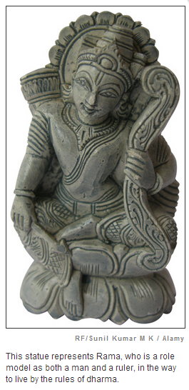
Introduction
In this chapter, you will learn about the origins and beliefs of Hinduism. Hinduism is the most influential set of religious beliefs in modern India.
The ancient traditions that gave rise to Hinduism have shaped Indian life in countless ways. This cultural heritage has affected how people worship, what jobs they do, and even what they eat. It has inspired great art and literature. And it has helped determine the status of people in Indian society.
One of the basic beliefs of Hinduism and some other Indian religions is dharma. Dharma refers to law, duty, and obligation. To follow one’s dharma means to dedicate oneself to performing one’s duties and to living by specific sets of rules.
The Ramayana, one of the most famous ancient literary texts, is sacred to many Hindus. It tells about life in ancient India and offers role models in dharma. For example, one of the central figures of the Ramayana, Rama, lives by the rules of dharma. When Rama is a young boy, he is a loyal son. When he grows up, he is a loving husband and a responsible ruler.
In this chapter, you will explore the origins of Hinduism. Then you will learn about dharma and a number of other Hindu beliefs: Brahman, deities, karma, and samsara.

Slide 3
Key Content Terms
Hinduism: a religion that developed in India over many centuries; it traces its roots to older traditions, such as Vedic beliefs and Brahmanism
Vedas: a collection of ancient writings viewed as sacred by many Hindus
Sanskrit: an ancient Indian language
Brahmanism: ancient ritual traditions in which Brahmins played a key role; it grew out of older Vedic religious beliefs and helped lead to Hinduism
caste: a class, or group, in Hindu society
Dharma: a belief found in Hinduism and other Indian traditions that a person has a duty or obligation to live an honorable life
Karma: a belief found in Hinduism and other Indian traditions that the good and evil done in a past life determines the nature of that person’s next life
reincarnation: the belief that a person’s soul is reborn into a new body after death
pilgrimages: a journey to a holy place

Slide 4
Section 2 - The Origins of Hinduism
No single person founded Hinduism. It developed slowly, over a long period of time, growing out of centuries of older traditions.
In the second millennium B.C.E., nomadic people speaking Indo-European languages migrated into northern India. These nomads, sometimes called Aryans (AIR-ee-uhnz), brought to India their gods and rituals, some of which eventually became part of Hinduism. Other aspects of Hinduism drew on local traditions, which, over thousands of years, allowed a wide range of practices and beliefs to arise in different parts of India.

Slide 5
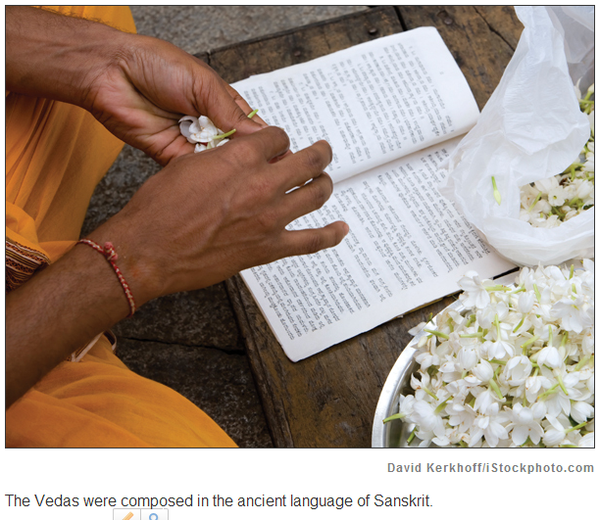
The oldest roots of Hinduism are found in Vedic religion, which is named for the earliest Indian texts. The Vedas (VAYduhz) are a collection of sacred texts, including verses, hymns, prayers, and teachings composed in Sanskrit (SAN-skrit). (Veda is Sanskrit for “knowledge.”) The earliest of the Vedas grew out of traditions brought into India by the Aryans. These traditions expanded over centuries in India, as the teachings of the Vedas were handed down orally from generation to generation, before India had a written form of Sanskrit.

Slide 6
Vedic rituals and sacrifices honored a number of deities (gods and goddesses) associated with nature and social order. Over time, these rituals became more complex. A class of priests and religious scholars, called Brahmins (BRAH-minz), grew increasingly important. They were responsible for correctly interpreting the Vedas and performing the required rituals. Brahmins eventually became the dominant class in India. Later Vedic religion is often called Brahmanism. The word Hinduism, the term for the traditions that grew out of later Vedic religion or Brahmanism, came much later.
Modern-day Hinduism is a very complex religion. Many beliefs, forms of worship, and deities exist side by side, and often differ from place to place. The Vedas, to which Hinduism traces its early roots, remain sacred to many Hindus today. Along with later sacred texts, the Vedas lay out some of the basic beliefs of Hinduism. As you will see, these beliefs have influenced every aspect of life in India.

Slide 7
Section 3 - Hinduism and the Caste System
Brahmanism was more than a religion in ancient India. It was a way of life. It affected how Indians lived, what they believed, and even the way they organized their society. Many of those ideas live on in modern Hinduism.
Brahmanism taught that a well-organized society was divided into different social classes. Today, we call this practice of social organization, developed in India, the caste system. The Vedas describe four main social classes, or varnas:
• Brahmins (priests and religious scholars) • Kshatriyas (KSHA-tree-uhs) (rulers and warriors) • Vaishyas (VIESH-yuhs) (herders and merchants) • Shudras (SHOO-druhs) (servants, farmers, and laborers)

Slide 8
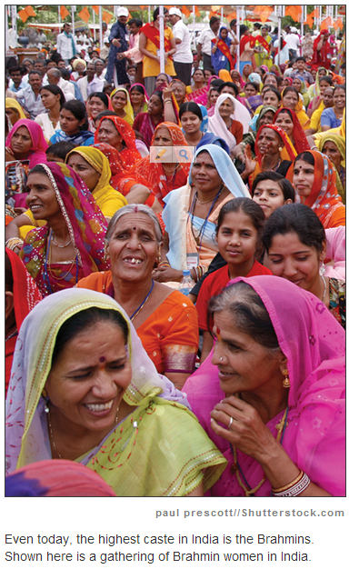
According to the Vedas, each class, or varna, had its own duties. For example, Brahmins had a duty to study and teach the Vedas. Warriors had a duty to become skilled with weapons. But the caste system meant that some people were favored much more than others. Brahmins held the highest place in society, while Shudras held the lowest.

Slide 9
Over the centuries, the caste system in India grew very complex. By medieval times, there were thousands of castes. The people in the lowest caste were known as Untouchables. Their descendants today often call themselves Dalits, from a word meaning “suppressed” or “crushed.” This group had jobs or ways of life that involved activities that high-caste Indians considered lowly or “dirty,” such as handling garbage and dead animals. Untouchables often had to live in their own villages or neighborhoods. They could not enter many temples or attend most schools. Other Hindus avoided touching, and in many cases, even looking at this group of people. Some of these rules separating the lowest caste remain today.
The caste system affected all aspects of people’s lives. Indians were born into a certain caste, and they could not change it. They could only marry within their own caste. Today, caste discrimination is outlawed in India. But despite the laws, caste status continues to affect many parts of Indian life.
This way of organizing society is just one example of how ancient religion affected daily life in India. Let’s look now at other aspects of Hinduism and how they helped shape Indian life and culture.

Slide 10
Hindu Caste System You are to create an image, or set of images, that represents the social structure of the Hindu caste system. Your assignment should show the jobs/duties of each caste and also how they rank in power compared to the other classes. 12 points total
Class | 1 pt | 1 pt | 1 pt
Brahmins | Named in poster | Correct job description shown in pictures | Placed to show power correctly
Kshatriyas | Named in poster | Correct job description shown in pictures | Placed to show power correctly
Vaishyas | Named in poster | Correct job description shown in pictures | Placed to show power correctly
Shudras | Named in poster | Correct job description shown in pictures | Placed to show power correctly

Slide 11
Section 4 - Hindu Beliefs About Brahman
Brahman is the name of a supreme power, or a divine force, that some Hindus believe is greater than all other deities. To these Hindus, only Brahman exists forever. Everything else in the world changes, from the passing seasons to all living things that eventually die.
In many Indian traditions, including Hinduism, time moves forward in a circle, like a great wheel. The same events return, just as the sun rises each morning, and spring follows winter. Some Hindus see this cycle as the work of Brahman, who is constantly creating, destroying, and re-creating the universe. The cycle never ends.

Slide 12
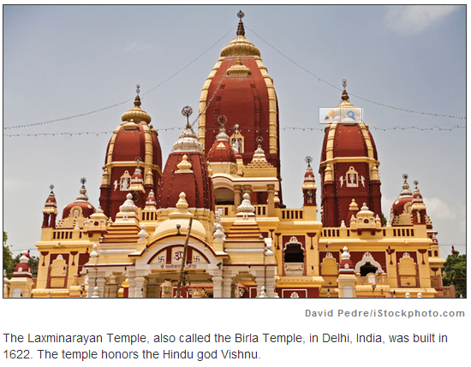
According to Hindus following these traditions, everything in the world is a part of Brahman, including the human soul. Ancient Hindus called the soul atman. In certain traditions, Hindus view the soul as part of Brahman, just as a drop of water is part of the ocean. Through their souls, people are therefore connected to Brahman.
In these traditions, the other deities worshipped in Hinduism are simply different forms of Brahman. Other Hindus have different beliefs about Hindu gods, such as Vishnu (VISH-noo) and Shiva (SHIH-vuh).

Slide 13
To communicate with their deities, followers of the ancient Vedic religion and Brahmanism held their elaborate rites and sacrifices outdoors. In later Hindu times, as Indian civilization developed and cities grew, people began to build massive temples for worship. Today, many modern Hindu temples are modeled after the ancient principles used to design those early temples.
Many Hindu temples are magnificent in size and design. Their doors often face east, toward the rising sun. The buildings are covered with beautiful carvings and sculptures. These works of art usually show deities from Hindu sacred texts. The temple interiors usually contain a tower and a small shrine.

Slide 14
Section 5 - Hindu Beliefs About Deities
There are many deities in Hindu sacred texts and worship rituals. Over time, as we learned earlier, some Hindus came to believe that all the deities were different faces of a supreme force, Brahman. For these Hindus, each god represented a power or quality of Brahman.
Today, in some Hindu traditions, there are three important deities. They are Brahma (BRAH-mah) (not Brahman), Vishnu, and Shiva. Each deity controls one aspect of the universe. Brahma creates it, Vishnu preserves it, and Shiva destroys it. In other Indian traditions, another goddess named Devi (DAY-vee) embodies the female powers of the universe.

Slide 15
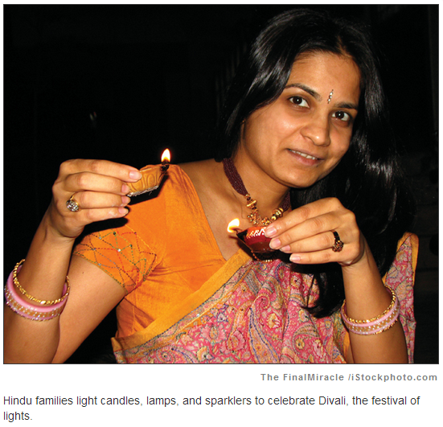
Ancient Hindu sacred texts often describe heroic deities battling evil. One famous story is found in the Ramayana. It tells of Rama’s fierce battle with Ravana, a demon (evil spirit). Such tales present in an entertaining way some of what later became Hindu beliefs. Many Hindu children have learned about their religion by listening to readings of the Ramayana, or in recent years, by seeing the stories dramatized on television.
Ancient literary texts like the Ramayana, which some Hindus view as sacred, have inspired many Hindu holidays and festivals. The Hindu New Year is celebrated at the Divali (dih-VAH-lee) festival. Divali means “row of lamps.” The lamps are symbols of good (light) winning over evil (darkness). They are often said to represent Rama’s triumph over the evil Ravana, and the start of the Hindu New Year.

Slide 16
Hindu gods/ goddesses
God/goddess | Basic description
Agni | god of fire
Brahma | unseen, all powerful
Durga | protects the universe
Ganesh | god of success & remover of obstacles
Hanuman | He is strong, full of valor, with various skills and powers, yet mischievous
Indra | god of thunder, rain, king of gods in heaven
Lakshmi | wealth and good fortune
Mahadevi | Hindu mother goddess
Rama | symbol of courtesy and virtue and is believed to have born on this earth to destroy the evil forces here
Sarasvati | wisdom and learning
Shiva | destroys old life to make room for new
Surya | god of the sun
Varuna | maintains cosmic order,
Vayu | god of wind
Vishnu | kind, loving, giver and provider of things

